Slide 1
BCPR283 Best Programming Practice (C#.NET)
Sokoban
Final Presentation
Made by: Bikrant Kataria

Slide 2
Section A
Code

Slide 3
Self Marking
Tasks | Marks
Manually Lay-Out of Components using Model One – Windows Form | 8
System.Drawing using Model One – Windows Form | 8
Rebuilt of the Model Created for 15% Halfway presentation | 8
System.Drawing using Model Two – Windows Form | 8
Programmatically Created Components using Model Two – Windows Form | 8
Q1.Describe and use common Design Patterns, Algorithms and programming language Idioms. | 5
Q3. Design programs. | 5
Total | 50

Slide 4
Model One - Game Player
Created for 15% Halfway presentation
Implement a View in Windows forms
Using
Manually lay-out of components

Slide 5
5 MUST Features of View
Display a grid of variable size (to an upper limit) CENTRED
Display the Pieces as distinct images
Display the move count
Save and load ‘works’ (as in passes to a Filer or NOT)
Actually works – is playable - updates!
3 SHOULD Features of View
Main Menu
Display pop-up box when level win
Level Selector

Slide 6
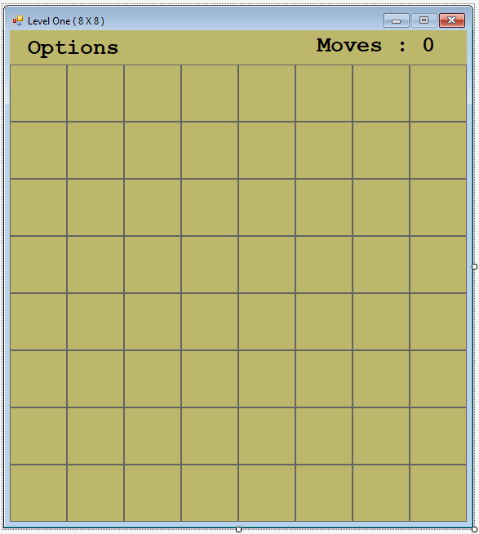
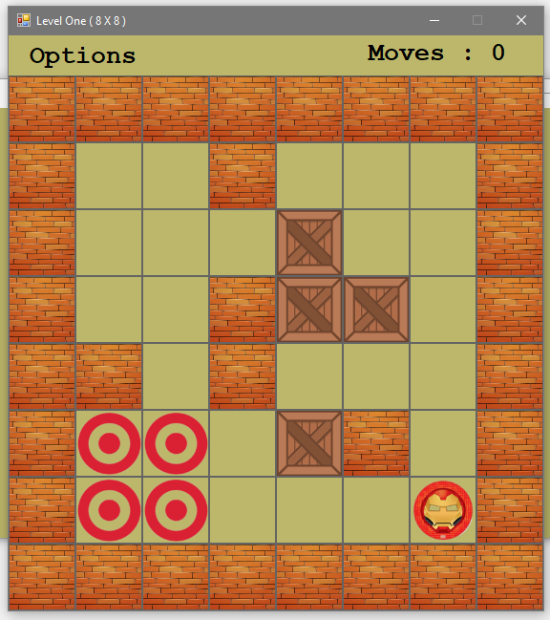
Manually lay-out (PictureBox)
Before Game Start
After Game Start

Slide 7
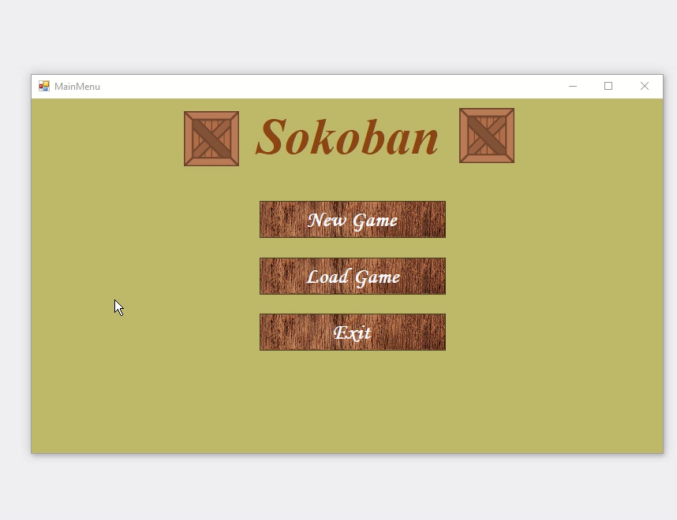
Model One - Manually lay-out of components
Feature 1: Display a grid of variable size
Play the video to see the demo
Code for this feature in provided in the next slide…

Slide 8
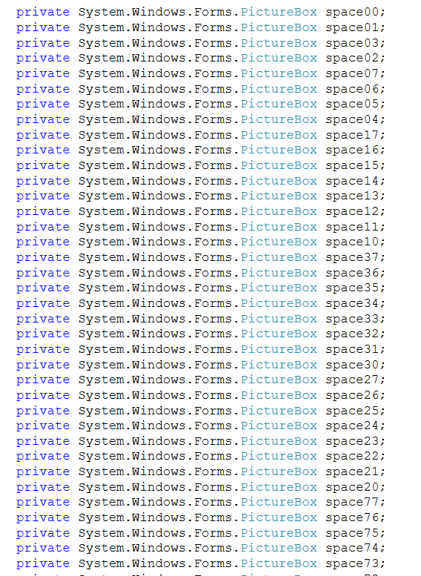
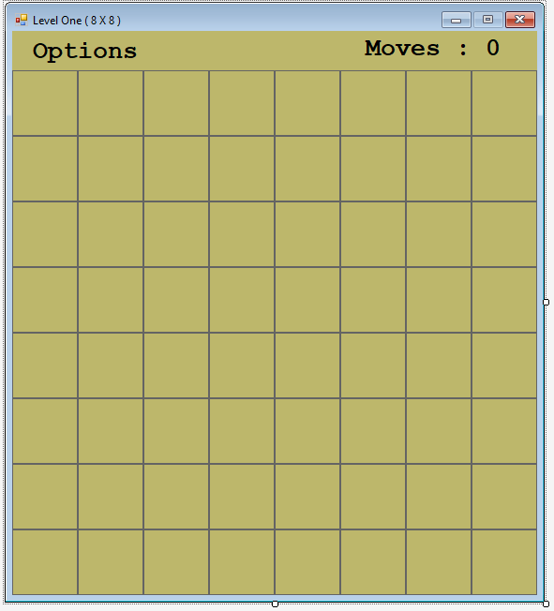
Code for Feature 1: Display a grid of variable size
Reference: ModelOne-WinForms-Manual\GamePlayer\ControllerView\LevelOne.Desiner.cs

Slide 9
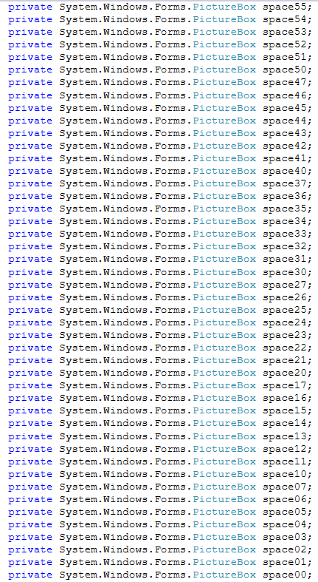
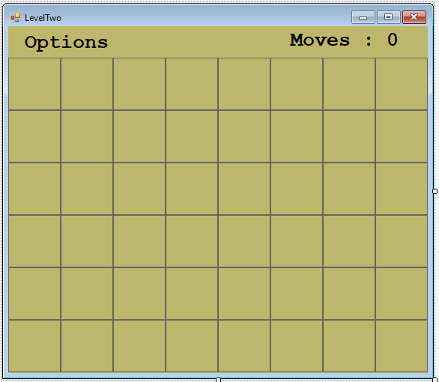
Code for Feature 1: Display a grid of variable size
Reference: ModelOne-WinForms-Manual\GamePlayer\ControllerView\LevelTwo.Desiner.cs

Slide 10
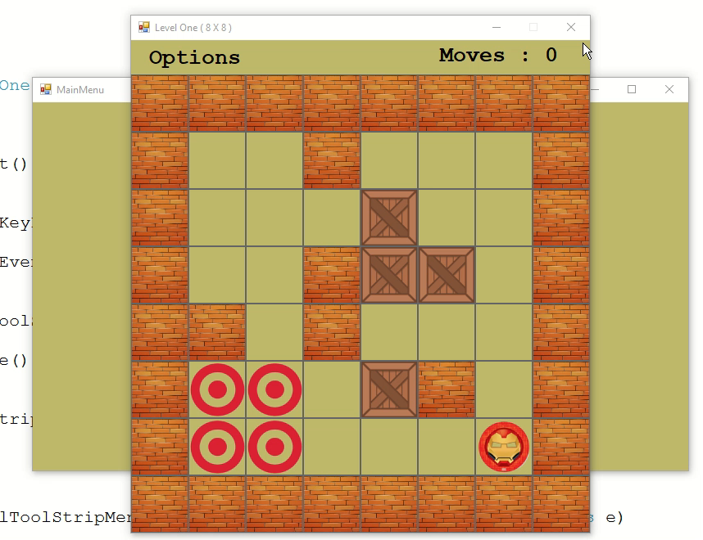
Model One - Manually lay-out of components
Feature 2: Display the Pieces as distinct images
Play the video to see the demo
Code for this feature in provided in the next slide…

Slide 11
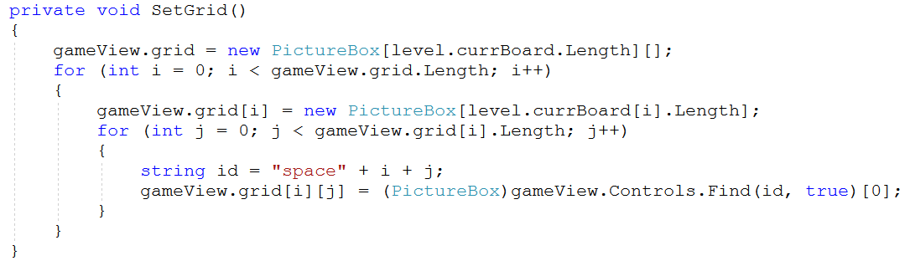
Feature 2: Display the Pieces as distinct images
Reference: ModelOne-WinForms-Manual\GamePlayer\ControllerView\GameController.cs Lines 28 - 40
More code in the next slide…

Slide 12
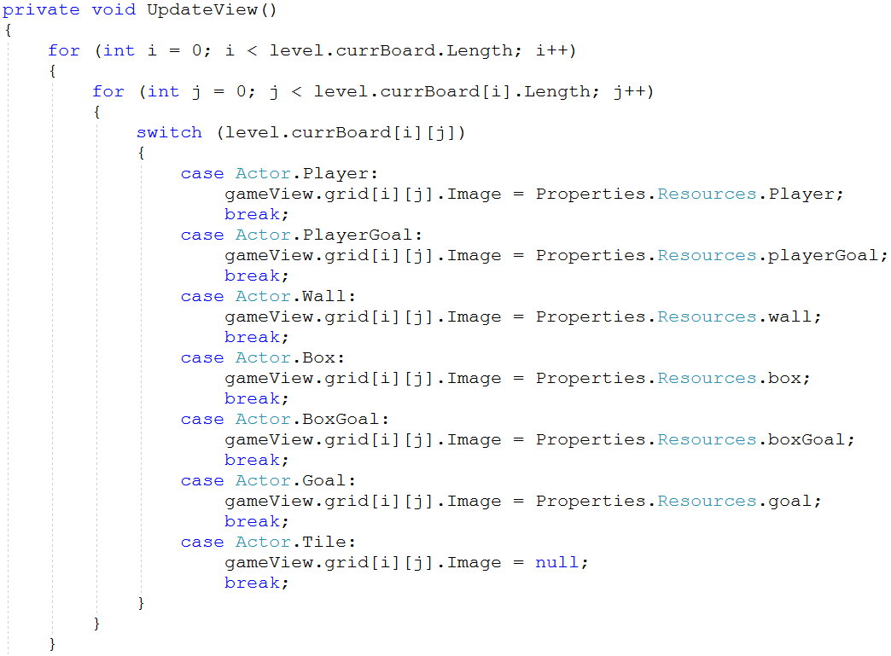
Feature 2: Display the Pieces as distinct images
Reference: ModelOne-WinForms-Manual\GamePlayer\ControllerView\GameController.cs Lines 51 - 83

Slide 13
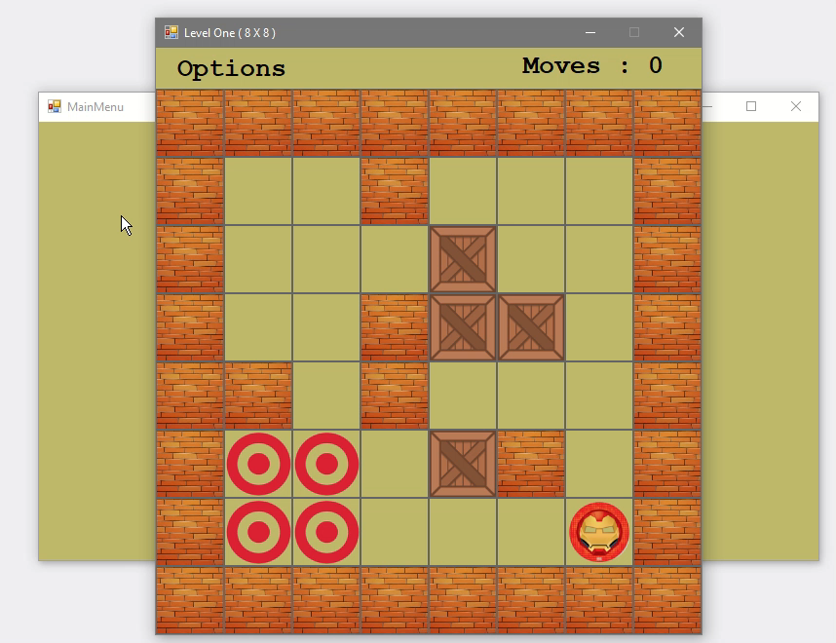
Model One - Manually lay-out of components
Feature 3: Display the move count
Play the video to see the demo
Code for this feature in provided in the next slide…

Slide 14
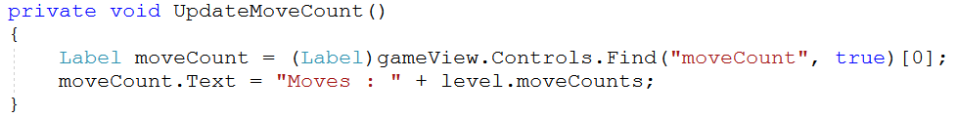
Feature 3: Display the move count
Reference: ModelOne-WinForms-Manual\GamePlayer\ControllerView\GameController.cs Lines 22 - 26

Slide 15
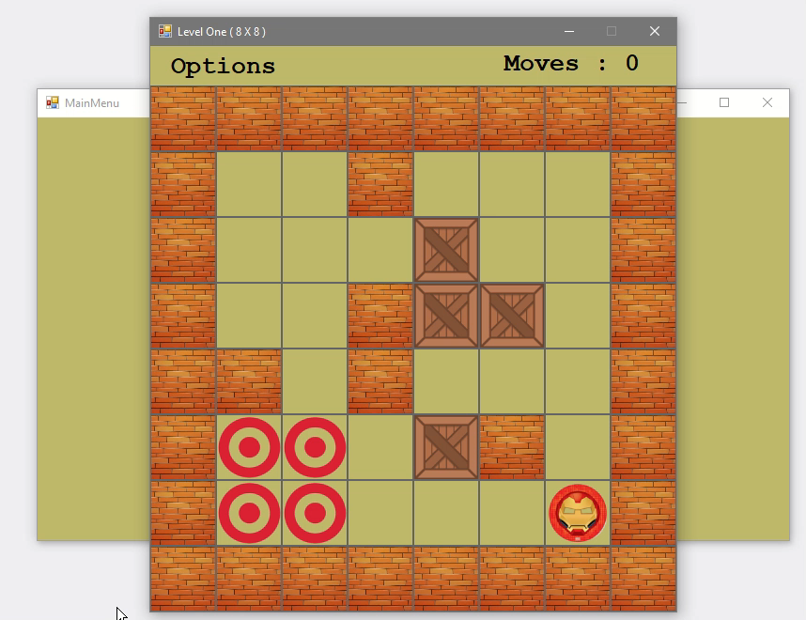
Model One - Manually lay-out of components
Feature 4: Save and load ‘works’
Play the video to see the demo
Code for this feature in provided in the next slide…

Slide 16
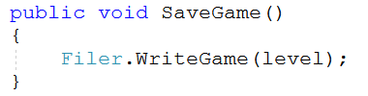
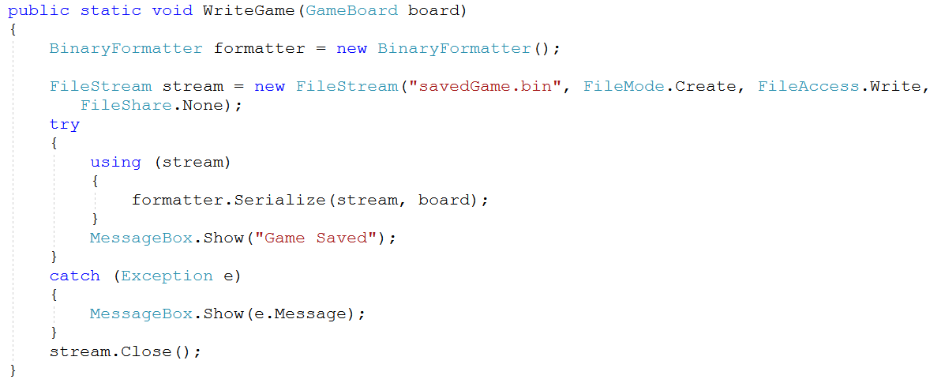
Feature 4: Save and load ‘works’
Reference: ModelOne-WinForms-Manual\GamePlayer\ControllerView\GameController.cs Lines 117 - 121
Reference: ModelOne-WinForms-Manual\GamePlayer\ControllerView\Filer.cs Lines 11 - 29
More code in the next slide…

Slide 17
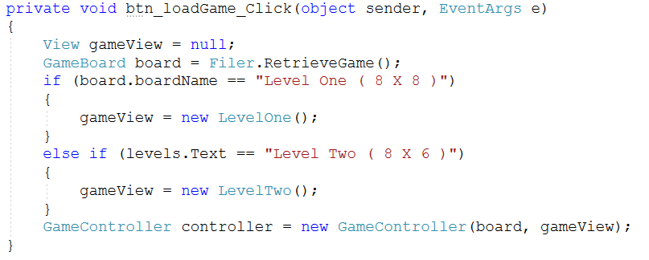
Feature 4: Save and load ‘works’
Reference: ModelOne-WinForms-Manual\GamePlayer\ControllerView\MainMenu.cs Lines 52 - 65
More code in the next slide…

Slide 18
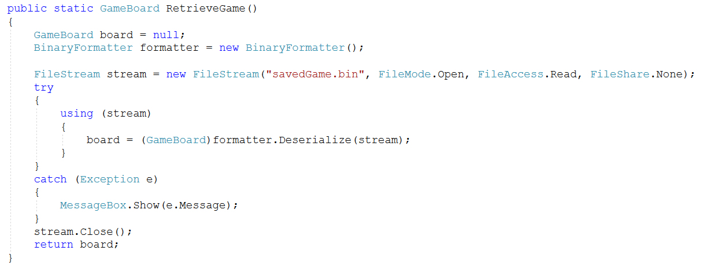
Feature 4: Save and load ‘works’
Reference: ModelOne-WinForms-Manual\GamePlayer\ControllerView\Filer.cs Lines 31 - 51

Slide 19
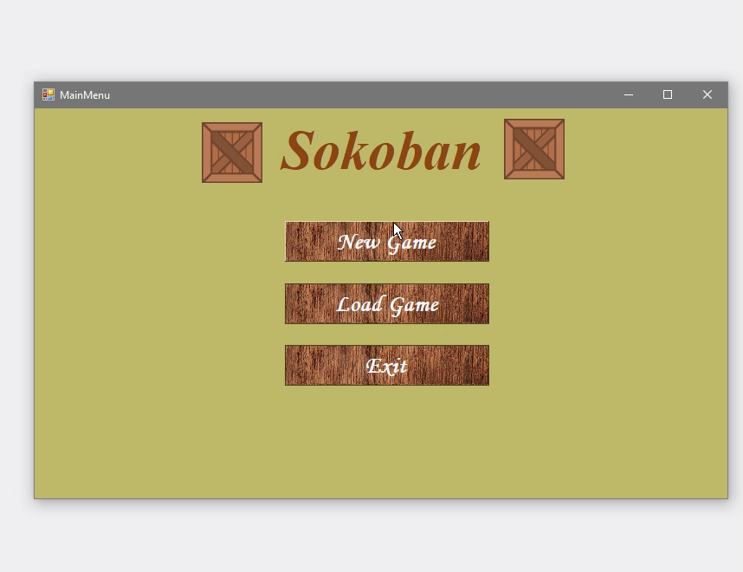
Model One - Manually lay-out of components
Feature 5: Actually works – is playable - updates!
Play the video to see the demo
Code for this feature in provided in the next slide…

Slide 20
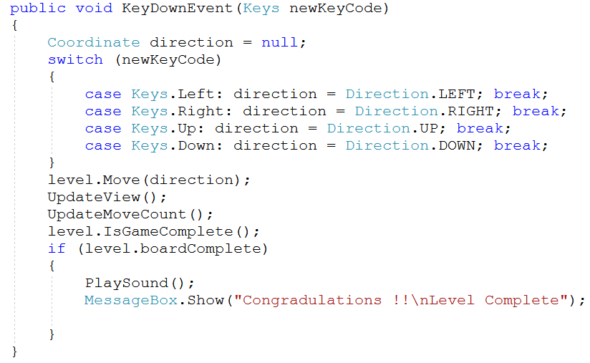
Feature 5: Actually works – is playable - updates!
Reference: ModelOne-WinForms-Manual\GamePlayer\ControllerView\GameController.cs Lines 86 - 106
More code in the next slide…

Slide 21
Feature 5: Actually works – is playable - updates!
Reference: ModelOne-WinForms-Manual\GamePlayer\ControllerView\GameController.cs Lines 28 - 40
More code in the next slide…

Slide 22
Feature 5: Actually works – is playable - updates!
Reference: ModelOne-WinForms-Manual\GamePlayer\ControllerView\GameController.cs Lines 51 - 83

Slide 23

Model One - Manually lay-out of components
Feature 6: Main Menu
Play the video to see the demo
Code for this feature in provided in the next slide…

Slide 24
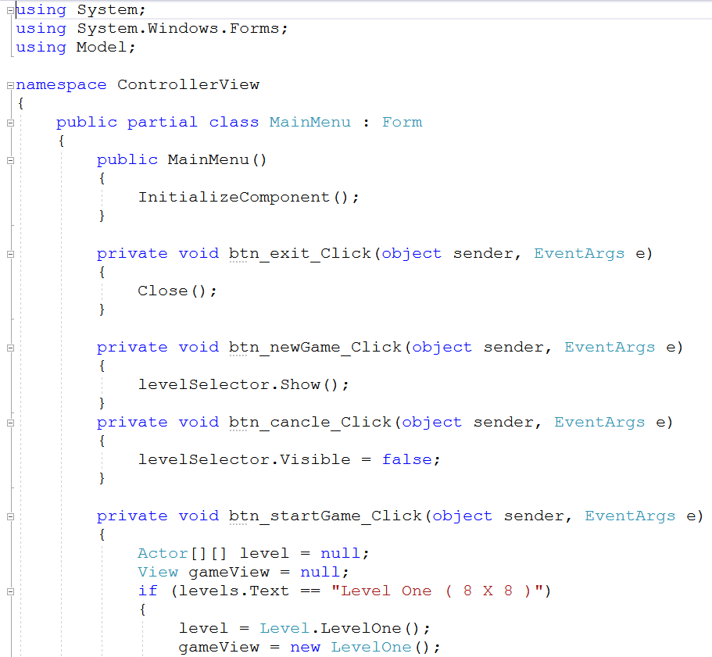
Feature 6: Main Menu
Reference: ModelOne-WinForms-Manual\GamePlayer\ControllerView\MainMenu.cs Lines 1 - 68
More code in the next slide…

Slide 25
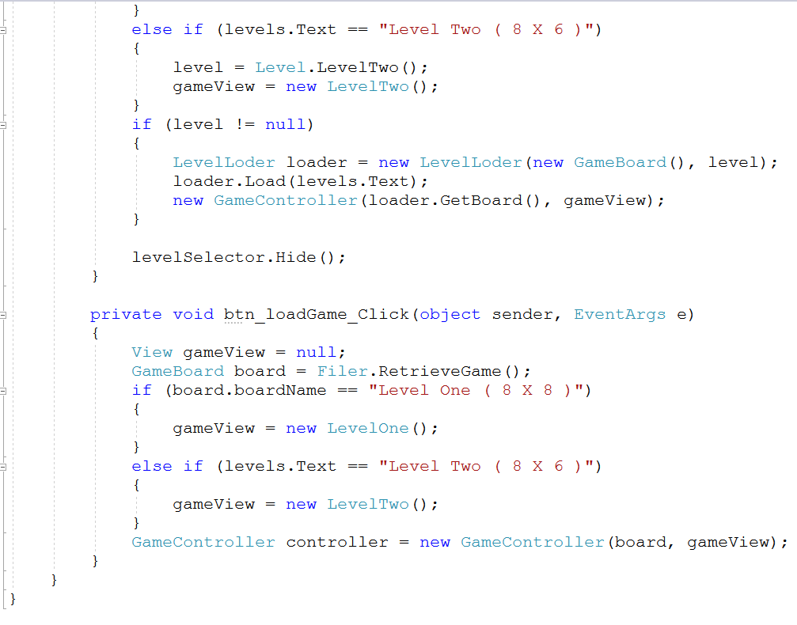
Feature 6: Main Menu
Reference: ModelOne-WinForms-Manual\GamePlayer\ControllerView\MainMenu.cs Lines 1 - 68

Slide 26
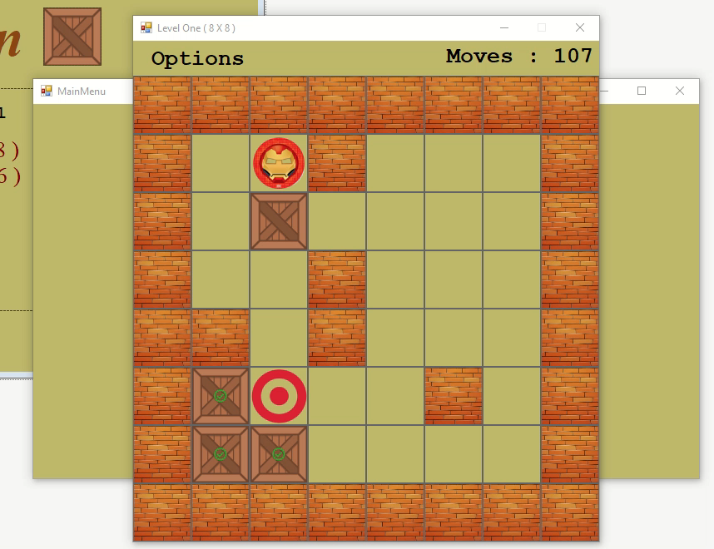
Model One - Manually lay-out of components
Feature 7: Display pop-up box when level win
Play the video to see the demo
Code for this feature in provided in the next slide…

Slide 27
Feature 7: Display pop-up box when level win
Reference: ModelOne-WinForms-Manual\GamePlayer\ControllerView\GameController.cs Lines 86 - 106

Slide 28

Model One - Manually lay-out of components
Feature 8: Level Selector
Play the video to see the demo
Code for this feature in provided in the next slide…

Slide 29
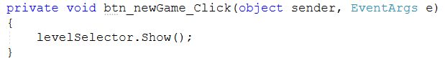
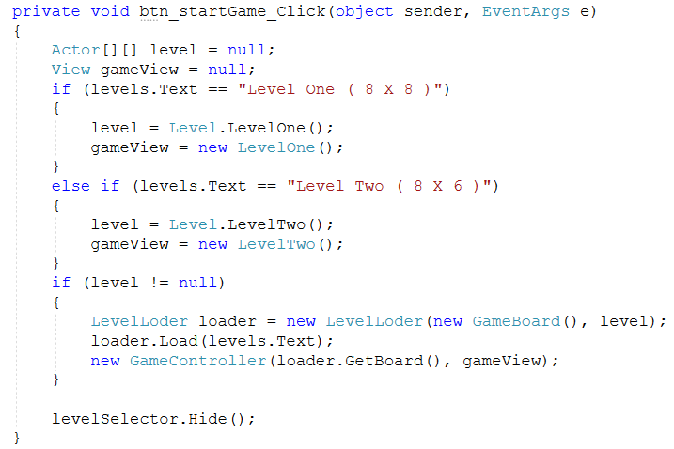
Feature 8: Level Selector
Reference: ModelOne-WinForms-Manual\GamePlayer\ControllerView\MainMenu.cs Lines 19 - 22
Reference: ModelOne-WinForms-Manual\GamePlayer\ControllerView\GameController.cs Lines 28 - 50

Slide 30
Model One - Game Player
Created for 15% Halfway presentation
Implement a View in Windows forms
Using
System.Drawing

Slide 31
5 MUST Features of View
Display a grid of variable size (to an upper limit) CENTRED
Display the Pieces as distinct images
Display the move count
Save and load ‘works’ (as in passes to a Filer or NOT)
Actually works – is playable - updates!
3 SHOULD Features of View
Reset Level
Sound when win level
Exit Game

Slide 32
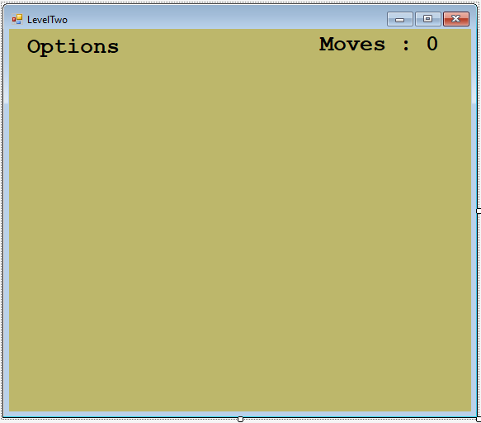
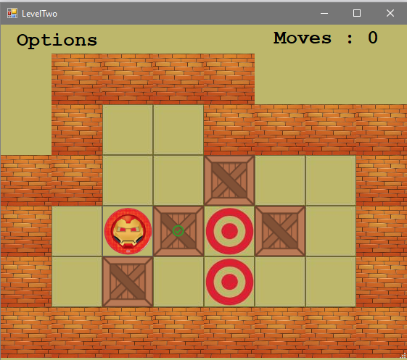
System.Drawing
Drawing individual image on the form using System.Drawing
Before Game Start
After Game Start

Slide 33
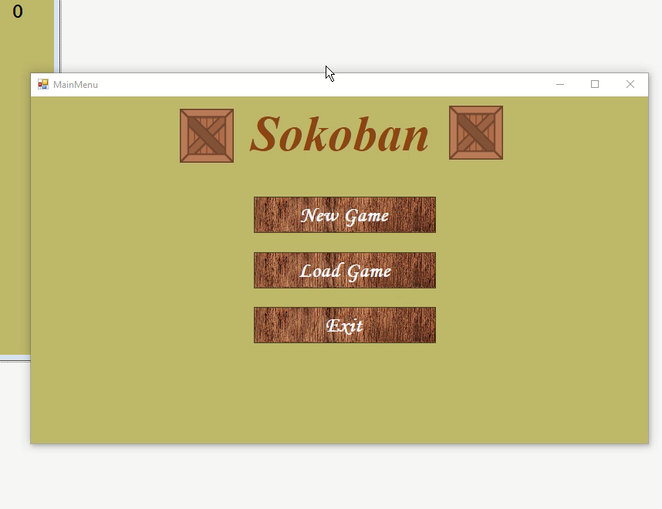
Model One – System.Drawing
Feature 1: Display a grid of variable size
Play the video to see the demo
Code for this feature in provided in the next slide…

Slide 34
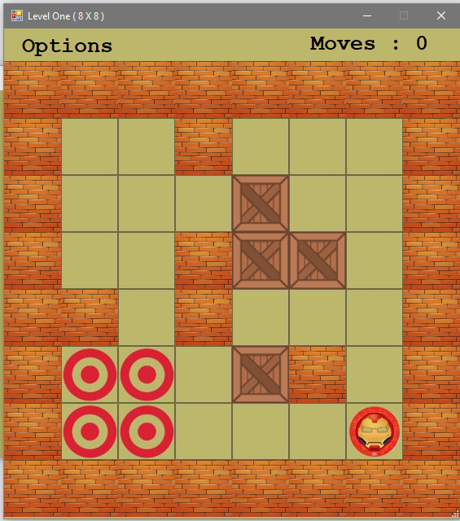
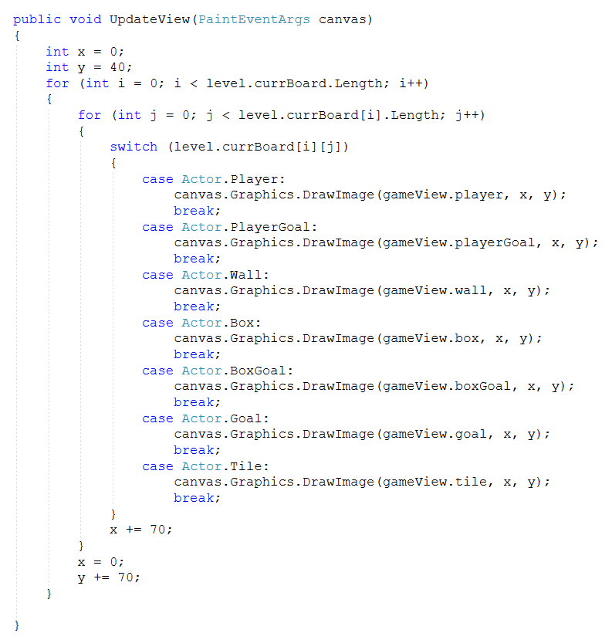
Code for Feature 1: Display a grid of variable size
Reference: ModelOne-WinForm-Drawing\GamePlayer\ControllerView\GameController.cs Lines 36 - 74

Slide 35
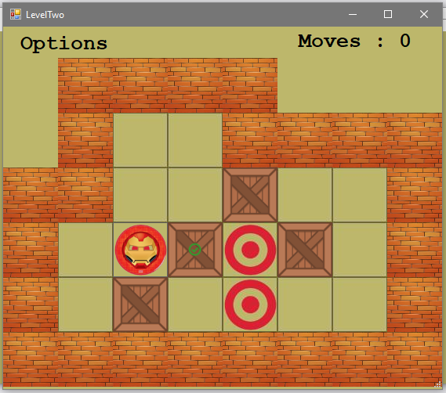
Code for Feature 1: Display a grid of variable size
Reference: ModelOne-WinForm-Drawing\GamePlayer\ControllerView\GameController.cs Lines 36 - 74

Slide 36

Model One – System.Drawing
Feature 2: Display the Pieces as distinct images
Play the video to see the demo
Code for this feature in provided in the next slide…

Slide 37
Feature 2: Display the Pieces as distinct images
Reference: ModelOne-WinForm-Drawing\GamePlayer\ControllerView\GameController.cs Lines 36 - 74
More code in the next slide…

Slide 38
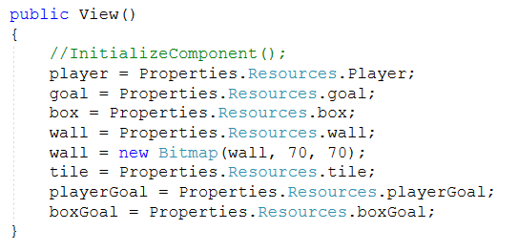
Feature 2: Display the Pieces as distinct images
Reference: ModelOne-WinForm-Drawing\GamePlayer\ControllerView\view.cs Lines 19 - 30

Slide 39
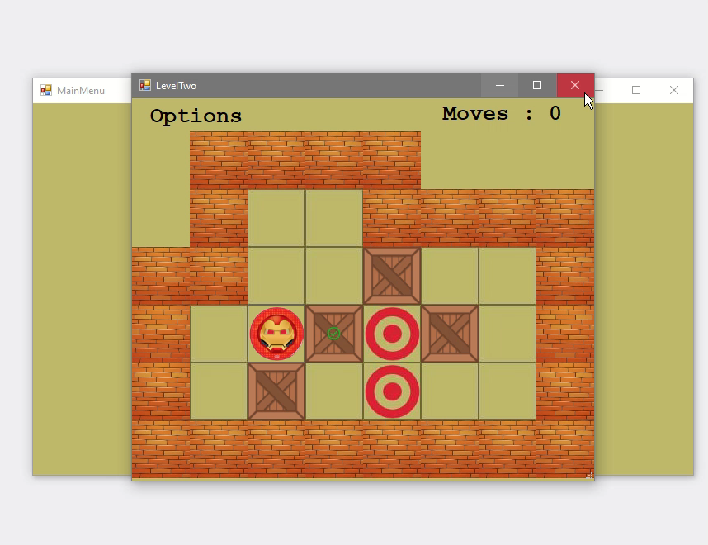
Model One – System.Drawing
Feature 3: Display the move count
Play the video to see the demo
Code for this feature in provided in the next slide…

Slide 40
Feature 3: Display the move count
Reference: ModelOne-WinForm-Drawing\GamePlayer\ControllerView\GameController.cs Lines 22 - 26

Slide 41

Model One – System.Drawing
Feature 4: Save and load ‘works’
Play the video to see the demo
Code for this feature in provided in the next slide…

Slide 42
Feature 4: Save and load ‘works’
Reference: ModelOne-WinForm-Drawing\GamePlayer\ControllerView\GameController.cs Lines 106 - 109
Reference: ModelOne-WinForm-Drawing\GamePlayer\ControllerView\Filer.cs Lines 11 - 29

Slide 43
Feature 4: Save and load ‘works’
Reference: ModelOne-WinForms-Manual\GamePlayer\ControllerView\MainMenu.cs Lines 52 - 65
More code in the next slide…

Slide 44
Feature 4: Save and load ‘works’
Reference: ModelOne-WinForms-Manual\GamePlayer\ControllerView\Filer.cs Lines 31 - 51

Slide 45

Model One – System.Drawing
Feature 5: Actually works – is playable - updates!
Play the video to see the demo
Code for this feature in provided in the next slide…

Slide 46
Feature 5: Actually works – is playable - updates!
Reference: ModelOne-WinForm-Drawing\GamePlayer\ControllerView\GameController.cs Lines 76 - 95
More code in the next slide…

Slide 47
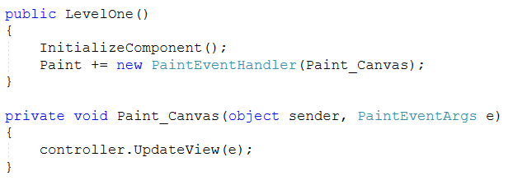
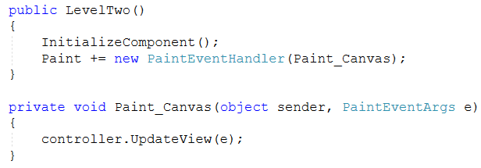
Feature 5: Actually works – is playable - updates!
Reference: ModelOne-WinForm-Drawing\GamePlayer\ControllerView\LevelOne.cs Lines 8 - 17
Reference: ModelOne-WinForm-Drawing\GamePlayer\ControllerView\LevelTwo.cs Lines 8 - 17
More code in the next slide…

Slide 48
Feature 5: Actually works – is playable - updates!
Reference: ModelOne-WinForm-Drawing\GamePlayer\ControllerView\GameController.cs Lines 36 - 74
More code in the next slide…

Slide 49
Model One – System.Drawing
Feature 6: Reset Level
Play the video to see the demo
Code for this feature in provided in the next slide…

Slide 50
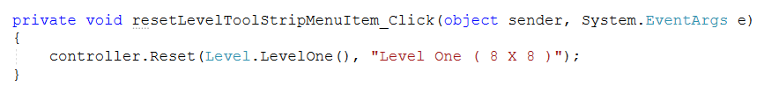
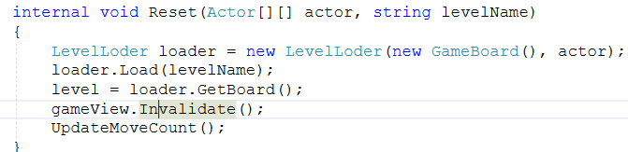
Feature 6: Reset Level
Reference: ModelOne-WinForm-Drawing\GamePlayer\ControllerView\LevelTwo.cs Lines 30 - 33
Reference: ModelOne-WinForm-Drawing\GamePlayer\ControllerView\LevelOne.cs Lines 35 - 38
Reference: ModelOne-WinForm-Drawing\GamePlayer\ControllerView\GameController.cs Lines 27 - 34

Slide 51
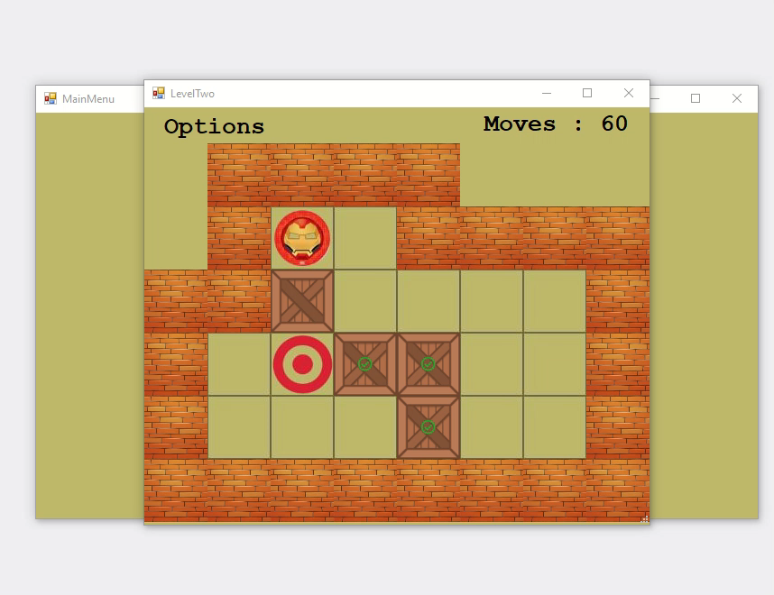
Model One – System.Drawing
Feature 7: Sound when win level
Play the video to see the demo
Code for this feature in provided in the next slide…

Slide 52
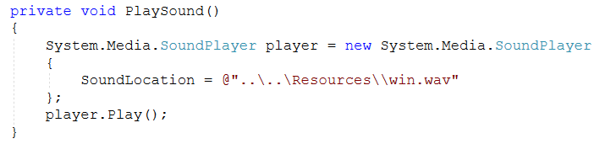
Feature 7: Sound when win level
Reference: ModelOne-WinForm-Drawing\GamePlayer\ControllerView\GameController.cs Lines 86 - 106
Reference: ModelOne-WinForm-Drawing\GamePlayer\ControllerView\GameController.cs Lines 97 - 104

Slide 53
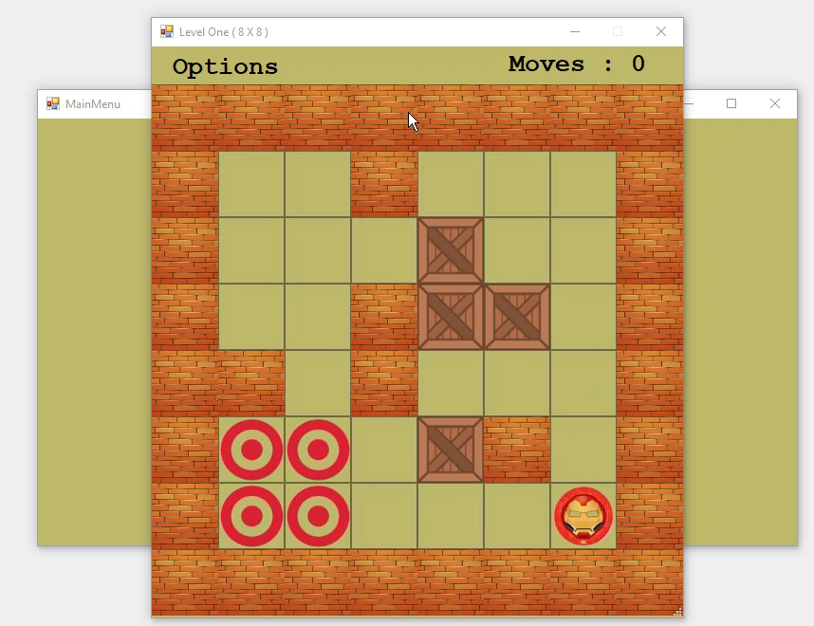
Model One – System.Drawing
Feature 8: Exit Game
Play the video to see the demo
Code for this feature in provided in the next slide…

Slide 54
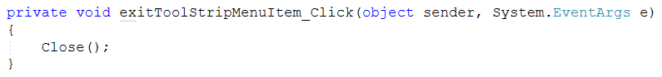
Feature 6: Exit Game
Level One
Reference: ModelOne-WinForm-Drawing\GamePlayer\ControllerView\LevelOne Lines 30 - 33
Level Two
Reference: ModelOne-WinForm-Drawing\GamePlayer\ControllerView\LevelOne Lines 35 - 39

Slide 55
Model Two - Game Player
Rebuilt of the Model Created for 15% Halfway presentation

Slide 56
Sokoban Game Player – Must Features
13. Player can only move one box at a time.
14. Player move into the tile if the box is moved.
15. Player can be on the goal.
16. Player can go through the goal.
17. Player can't go through the box.
18. Player can't go through the wall.
19. Box cannot not go through the wall.
20. Box can be on the goal.
21. Box can be moved from the goal.
22. Player cannot move the wall.
23. Indication when the box is on the goal
24. Level is complete when all the box are on the goal
25. Count player moves
1. There is only one Player.
2. There is at least one Box.
3. There is at least one Goal.
4. Player can move one step at a time.
5. Player can move up.
6. Player can move down.
7. Player can move left.
8. Player can move right.
9. Player can move the box left.
10. Player can move the box right.
11. Player can move the box up.
12. Player can move the box down.

Slide 57
Sokoban Game Player – Must Features Implementation
1. There is only one Player
File: Wharehouse.cs
Class Wharehouse, property mover.
2. There is at least one Box
File: Wharehouse.cs
Class Wharehouse, property allMyBoxes
3. There is at least one Goal
File: Wharehouse.cs
Class Wharehouse, property allMyGoals

Slide 58
Sokoban Game Player Must Features Implementation
4. Player can move one step at a time
5. Player can move up
6. Player can move down
7. Player can move left
8. Player can move right
File Wharehouse.cs
Class Wharehouse, method Organise( ) and
File Mover.cs
Class Player method, ProcessMove( ) is used for moving the Player is the specified direction.

Slide 59
Sokoban Game Player Must Features Implementation
9. Player can move the box left
10. Player can move the box right
11. Player can move the box up
12. Player can move the box down
File Wharehouse.cs
Class Wharehouse, method Organise( ) and
File Mover.cs
Class Player method, ProcessMove( ) is used for moving the Player is the specified direction.
File Box.cs
Class Box, method ProcessMove( ) is used for moving the Box is the specified direction

Slide 60
Sokoban Game Player Must Features Implementation
13. Player can only move one box at a time
File Wharehouse.cs
Class Wharehouse, method Organise( ) and
File Mover.cs
Class Player method, ProcessMove( ) is used for moving the Player is the specified direction.
File Box.cs
Class Box, method ProcessMove( ) is used for moving the Box is the specified direction
File Actor.cs
Class Actor, method GetNextPos( ) is used to get next position of the box which add 1 to the position based on the direction.

Slide 61
Sokoban Game Player Must Features Implementation
14. Player move into the tile if the box is moved
File Wharehouse.cs
Class Wharehouse, method Organise( ) and
File Mover.cs
Class Player method, ProcessMove( ) is used for moving the Player is the specified direction.
15. Player can be on the goal
16. Player can go through the goal
20. Box can be on the goal.
21. Box can be moved from the goal
File Wharehouse.cs
Class Wharehouse, method CanMoveAt( ) if this method return true that means that the player and box can move in the supplied direction.

Slide 62
Sokoban Game Player Must Features Implementation
17. Player can't go through the box
18. Player can't go through the wall
19. Box cannot not go through the wall.
22. Player cannot move the wall
File Wharehouse.cs
Class Wharehouse, method CanMoveAt( ), Obstacle( ) & IsThereABoxAt( ) are used for implementing the above features 17, 18 ,19 and 22.

Slide 63
Sokoban Game Player Must Features Implementation
23. Indication when the box is on the goal
File Wharehouse.cs
Class Wharehouse, method CheckIfBoxesAreOnTheGoal ( ) and BoxIsOnTheGoal( ) is used for determining if box is on the Goal.
24. Level is complete when all the box are on the goal
File Wharehouse.cs
Class Wharehouse, method AllTheBoxesAreOnTheGoals ( ) if this method return true that means all the box are on the goal and the level is complete.
25. Count player moves
File Mover.cs
Class Mover.cs, method ProcessMove( ) updates player count every time player changes it position.

Slide 64
Model Two - Game Player
Rebuilt of the Model Created for 15% Halfway presentation
Implement a View in Windows forms
Using
System.Drawing

Slide 65
5 MUST Features of View
Display a grid of variable size (to an upper limit) CENTRED
Display the Pieces as distinct images
Display the move count
Save and load ‘works’ (as in passes to a Filer or NOT)
Actually works – is playable - updates!
3 SHOULD Features of View
Automatically load next level
Sound when both level complete
Exit Game

Slide 66
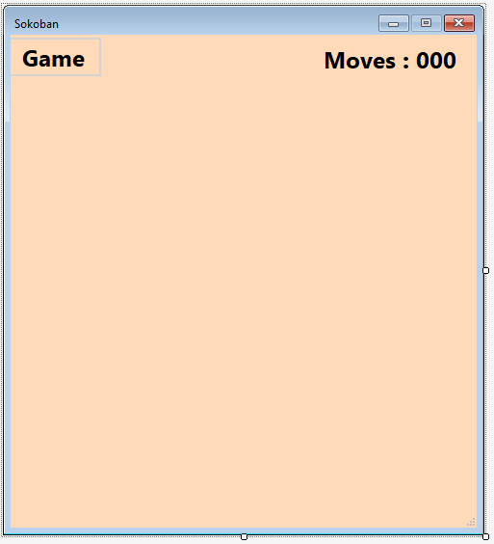
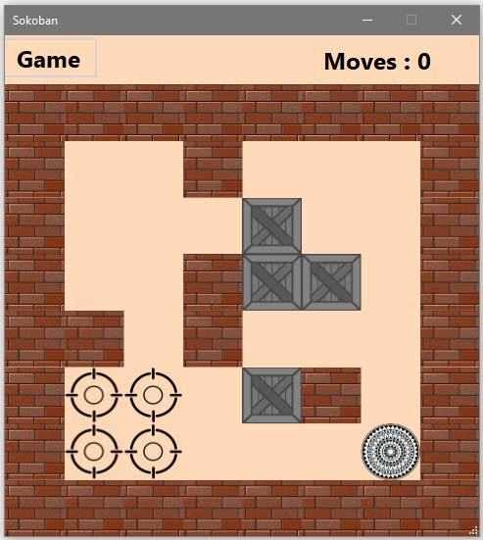
System.Drawing
Drawing individual image on the form using System.Drawing
Before Game Start
After Game Start

Slide 67

Model Two – System.Drawing
Feature 1: Display a grid of variable size
Play the video to see the demo
Code for this feature in provided in the next slide…

Slide 68
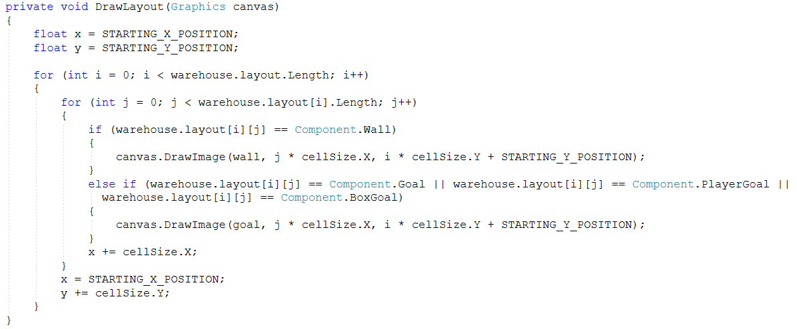
Code for Feature 1: Display a grid of variable size
Reference: ModelTwo-WinForm-Drawing\ModelTwo-WinForm-Drawing\View.cs Lines 92 - 114

Slide 69
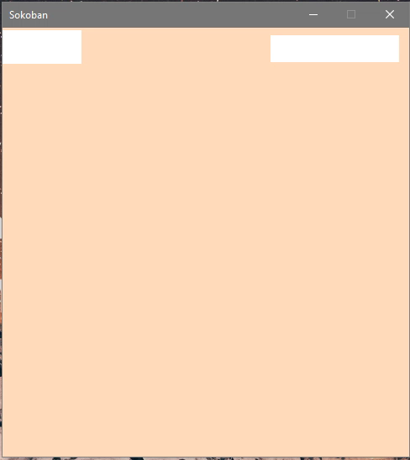
Model Two – System.Drawing
Feature 2: Display the Pieces as distinct images
Play the video to see the demo
Code for this feature in provided in the next slide…

Slide 70
Code for Feature 2: Display the Pieces as distinct images
Reference: ModelTwo-WinForm-Drawing\ModelTwo-WinForm-Drawing\View.cs Lines 92 - 114
More code in next slide …

Slide 71
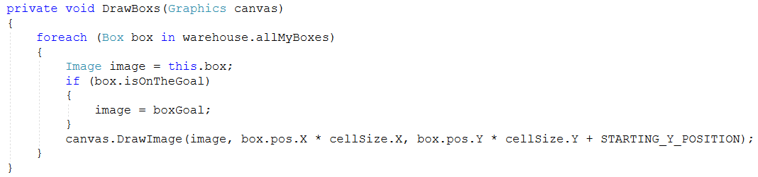
Code for Feature 2: Display the Pieces as distinct images
Reference: ModelTwo-WinForm-Drawing\ModelTwo-WinForm-Drawing\View.cs Lines 70 - 73
Reference: ModelTwo-WinForm-Drawing\ModelTwo-WinForm-Drawing\View.cs Lines 80 - 91

Slide 72
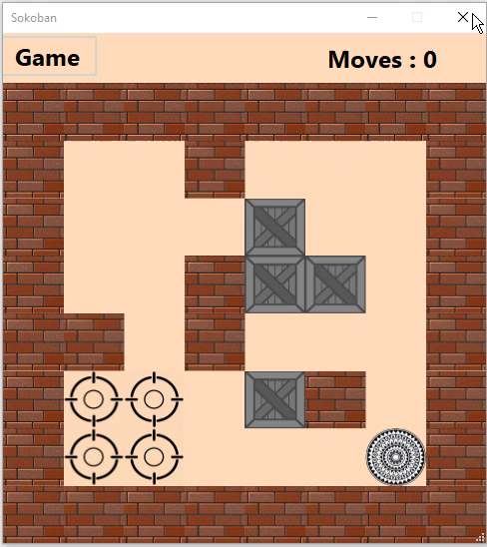
Model Two – System.Drawing
Feature 3: Display the move count
Play the video to see the demo
Code for this feature in provided in the next slide…

Slide 73
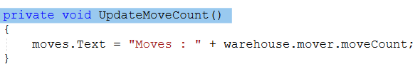
Code for Feature 3: Display the move count
Reference: ModelTwo-WinForm-Drawing\ModelTwo-WinForm-Drawing\ Lines 75 - 78

Slide 74
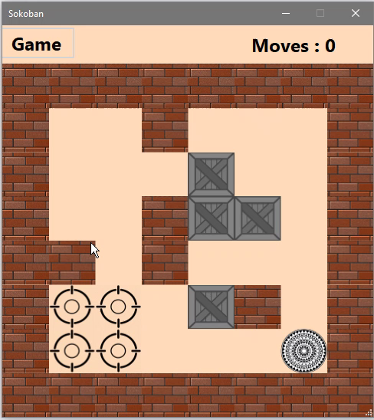
Model Two – System.Drawing
Feature 4: Save and load ‘works’
Play the video to see the demo
Code for this feature in provided in the next slide…

Slide 75
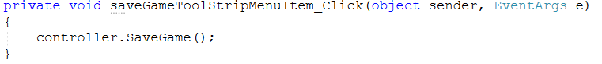
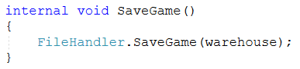

Code for Feature 4: Save ‘works’
Reference: ModelTwo-WinForm-Drawing\ModelTwo-WinForm-Drawing\View.cs Lines 125 - 128
Reference: ModelTwo-WinForm-Drawing\ModelTwo-WinForm-Drawing\GameCnotroller Lines 73 - 76
Reference: ModelTwo-WinForm-Drawing\ModelTwo-WinForm-Drawing\ Lines 10 - 25

Slide 76



Code for Feature 4: load ‘works’
Reference: ModelTwo-WinForm-Drawing\ModelTwo-WinForm-Drawing\View.cs Lines 130 - 133
Reference: ModelTwo-WinForm-Drawing\ModelTwo-WinForm-Drawing\GameCnotroller Lines 78 - 83
Reference: ModelTwo-WinForm-Drawing\ModelTwo-WinForm-Drawing\ Lines 27 - 43

Slide 77

Model Two – System.Drawing
Feature 5: Actually works – is playable - updates!
Play the video to see the demo
Code for this feature in provided in the next slide…

Slide 78

Code for Feature 5: Actually works – is playable - updates!
Reference: ModelTwo-WinForm-Drawing\ModelTwo-WinForm-Drawing\GameController.cs Lines 32 - 51
More code in next slide …

Slide 79


Code for Feature 5: Actually works – is playable - updates!
Reference: ModelTwo-WinForm-Drawing\ModelTwo-WinForm-Drawing\View.cs Lines 60 - 68
Reference: ModelTwo-WinForm-Drawing\ModelTwo-WinForm-Drawing\View.cs Lines 53 - 58
More code in next slide …

Slide 80

Code for Feature 5: Actually works – is playable - updates!
Reference: ModelTwo-WinForm-Drawing\ModelTwo-WinForm-Drawing\View.cs Lines 33 - 46
Reference: ModelTwo-WinForm-Drawing\ModelTwo-WinForm-Drawing\ Lines 75 - 78
More code in next slide …

Slide 81
Code for Feature 5: Actually works – is playable - updates!
Reference: ModelTwo-WinForm-Drawing\ModelTwo-WinForm-Drawing\View.cs Lines 92 - 114

Slide 82
Code for Feature 5: Actually works – is playable - updates!
Reference: ModelTwo-WinForm-Drawing\ModelTwo-WinForm-Drawing\View.cs Lines 70 - 73
Reference: ModelTwo-WinForm-Drawing\ModelTwo-WinForm-Drawing\View.cs Lines 80 - 91

Slide 83

Model Two – System.Drawing
Feature 6: Automatically load next level
Play the video to see the demo
Code for this feature in provided in the next slide…

Slide 84

Code for Feature 6: Automatically load next level
If the player is on Level one and has put all the boxes on the goal than load level two
Reference: ModelTwo-WinForm-Drawing\ModelTwo-WinForm-Drawing\GameController.cs Lines 32 - 71

Slide 85

Model Two – System.Drawing
Feature 7: Sound when both level are complete
Play the video to see the demo
Code for this feature in provided in the next slide…

Slide 86

Code for Feature 7: Sound when both level are complete
Play sound only when both level are completed
Reference: ModelTwo-WinForm-Drawing\ModelTwo-WinForm-Drawing\ Lines 53 - 71

Slide 87


Model Two – System.Drawing
Feature 8: Exit Game
Play the video to see the demo
Code for this feature
Reference: ModelTwo-WinForm-Drawing\ModelTwo-WinForm-Drawing\View.cs Lines 120 - 123

Slide 88
Model Two - Game Player
Rebuilt of the Model Created for 15% Halfway presentation
Implement a View in Windows forms
Using
Programmatically Created Components

Slide 89
5 MUST Features of View
Display a grid of variable size (to an upper limit) CENTRED
Display the Pieces as distinct images
Display the move count
Save and load ‘works’ (as in passes to a Filer or NOT)
Actually works – is playable - updates!
4 SHOULD Features of View
6. Display message when a level is complete
7. Sound when both level complete
8. Reset Game
9. New Game

Slide 90

Programmatically Created Components
Creating individual picture box on the form
Before Game Start
After Game Start

Slide 91



Model Two – Programmatically Created Components
Feature 1: Display a grid of variable size
Play the video to see the demo
Code for this feature
Reference: ModelTwo-WinForm-Drawing\ModelTwo-WinFrom-Programmatically\View.cs Lines 63 - 90

Slide 92

Model Two – Programmatically Created Components
Feature 2: Display the Pieces as distinct images
Play the video to see the demo
Code for this feature in provided in the next slide…

Slide 93

Code for Feature 2: Display the Pieces as distinct images
Reference: ModelTwo-WinForm-Drawing\ModelTwo-WinFrom-Programmatically\View.cs Lines 68 - 108

Slide 94


Model Two – Programmatically Created Components
Feature 3: Display the move count
Play the video to see the demo
Code for this feature
Reference: ModelTwo-WinForm-Drawing\ModelTwo-WinFrom-Programmatically\View.cs Lines 141 - 144

Slide 95

Model Two – Programmatically Created Components
Feature 4: Save and load ‘works’
Play the video to see the demo
Code for this feature in provided in the next slide…

Slide 96
Code for Feature 4: Save ‘works’
Reference: ModelTwo-WinForm-Drawing\ModelTwo-WinFrom-Programmatically\View.cs Lines 156 - 159
Reference: ModelTwo-WinForm-Drawing\ModelTwo-WinFrom-Programmatically\GameController.cs Lines 72 - 75
Reference: ModelTwo-WinForm-Drawing\ModelTwo-WinFrom-Programmatically\Filehandler.cs Lines 11 - 26

Slide 97
Code for Feature 4: load ‘works’
Reference: ModelTwo-WinForm-Drawing\ ModelTwo-WinFrom-Programmatically \View.cs Lines 161 - 164
Reference: ModelTwo-WinForm-Drawing\ ModelTwo-WinFrom-Programmatically \GameCnotroller Lines 77 - 82
Reference: ModelTwo-WinForm-Drawing\ ModelTwo-WinFrom-Programmatically \Filehandler.cs Lines 28 - 46

Slide 98
Model Two – Programmatically Created Components
Feature 5: Actually works – is playable - updates!
Play the video to see the demo
Code for this feature in provided in the next slide…

Slide 99
Code for Feature 5: Actually works – is playable - updates!
Reference: ModelTwo-WinForm-Drawing\ModelTwo-WinFrom-Programmatically\GameController.cs Lines 31 - 50
More code in next slide …

Slide 100



Code for Feature 5: Actually works – is playable - updates!
Reference: ModelTwo-WinForm-Drawing\ModelTwo-WinFrom-Programmatically\View.cs Lines 36 - 43
Reference: ModelTwo-WinForm-Drawing\ModelTwo-WinFrom-Programmatically\View.cs Lines 45 - 54
Reference: ModelTwo-WinForm-Drawing\ModelTwo-WinFrom-Programmatically\View.cs Lines 141 - 144
More code in next slide …

Slide 101
Code for Feature 5: Actually works – is playable - updates!
Reference: ModelTwo-WinForm-Drawing\ModelTwo-WinFrom-Programmatically\View.cs Lines 68 - 108

Slide 102

Model Two – Programmatically Created Components
Feature 6: Display message when a level is complete
Play the video to see the demo
Code for this feature in provided in the next slide…

Slide 103

Code for Feature 6: Display message when a level is complete
If the player is on Level Two and has put all the boxes on the goal
If the player is on Level one and has put all the boxes on the goal
Reference: ModelTwo-WinForm-Drawing\ModelTwo-WinFrom-Programmatically\View.cs Lines 92 - 114

Slide 104

Model Two – Programmatically Created Components
Feature 7: Sound when both level are complete
Play the video to see the demo
Code for this feature in provided in the next slide…

Slide 105
Code for Feature 7: Sound when both level are complete
Play sound only when both level are completed
Reference: ModelTwo-WinForm-Drawing\ModelTwo-WinFrom-Programmatically\GameController.cs Lines 52 - 70

Slide 106

Model Two – Programmatically Created Components
Feature 8: Reset Game
Play the video to see the demo
Code for this feature
Reference: ModelTwo-WinForm-Drawing\
ModelTwo-WinFrom-Programmatically\View.cs Lines 166 - 169
Reference: ModelTwo-WinForm-Drawing\ModelTwo-WinFrom-Programmatically\GameController.cs Lines 22 - 29

Slide 107


Model Two – Programmatically Created Components
Feature 9: New Game
Play the video to see the demo
Code for this feature
Reference: ModelTwo-WinForm-Drawing\
ModelTwo-WinFrom-Programmatically\View.cs Lines 171 - 175
Reference: ModelTwo-WinForm-Drawing\ModelTwo-WinFrom-Programmatically\GameController.cs Lines 22 - 29

Slide 108
Section B
Theory

Slide 109
Q1.Describe and use common Design Patterns, Algorithms and programming language Idioms.

Slide 110
Knowledge Point 1 Model–View–Viewmodel

Slide 111

1.1.1 Model–View–Viewmodel
(Knowledge point 1)
Model–View–ViewModel (MVVM) is a software architectural pattern.
MVVM facilitates a separation of development of the graphical user interface – be it via a markup language or GUI code – from development of the business logic or back-end logic (the data model).
The view model of MVVM is a value converter, meaning the view model is responsible for exposing (converting) the data objects from the model in such a way that objects are easily managed and presented. In this respect, the view model is more model than view, and handles most if not all of the view's display logic. The view model may implement a mediator pattern, organizing access to the back-end logic around the set of use cases supported by the view.
The obvious purpose is abstraction of the View, reducing the amount of business logic or glue code stuck in code-behind. All tasty goodness abstractly, but here's another concrete advantage: the ViewModel is easier to unit test than code-behind or event driven code. The ViewModel, though it sounds View-ish is really more Model-ish, and that means you can test it without awkward UI automation and interaction. If you've ever tried to unit test UI code, you know how hard that can be.
Reference: https://en.wikipedia.org/wiki/Model%E2%80%93view%E2%80%93viewmodel (Para 1)

Slide 112



1.1.2 Model–View–Viewmodel
(Implementation with example)
<< View>>
<< ViewModel>>
<< Model>>
Continued…
View.Desiner.cs GameController.cs Wharehouse.cs
Reference: ModelTwo-WinForm-Drawing\ModelTwo-WinFrom-Programmatically

Slide 113
1.1.2 Model–View–Viewmodel
(Implementation with example)
<< View>>
View.Desiner.cs
<< ViewModel>>
GameController
<< Model>>
Wharehouse
On slide 110 the code sample represents the View ViewModel and Model and here I have changed those code sample into individual class to explain how the MVVM pattern is applied to this assignment.
Here the View is represented by a class called view, this is a partial class. This is the user interface and there is another partial class called View which contains method that respond to the events generated by the user.
The view pass the events to the Controller, the user inputs are used for manipulating the Model which here is represented by the Wharehouse class.
The result of the manipulation, is passed back to the View.

Slide 114
1.1.3 Model–View–Viewmodel (Compare and contrast)
Model View Controller (MVC) vs Model–View–ViewModel (MVVM)
Model View Controller (MVC)
In the MVC pattern the controller acts as a tool that directly manipulates the data in its given model.
Each controller is designed to both receive data and send back appropriate information based on the data received.
The MVC pattern was specifically designed in such way that the view and the model don’t need to know anything about each other. Because of this, the MVC pattern allows developers to work simultaneously on different components of a web application without impacting one another.
For one, the use of controllers to manipulate data models creates clutter in the backend. It’s standard for each model in a database to have its own controller, so when an application scales much larger and evolves into an operation with many related models, the amount of controllers used must grow in tandem.
Model–View–ViewModel (MVVM)
Another popular method to connect the view to the model is through something un-creatively called a ViewModel. Unlike the controller method, the ViewModel method relies heavily on the frontend of the application.
Unlike the MVC method, the ViewModel isn’t a controller. It instead acts as a binder that binds data between the view and model. Whereas the MVC format is specifically designed to create a separation of concerns between the model and view, the MVVM format with data-binding is designed specifically to allow the view and model to communicate directly with each other.
MVVM format comes with its own flaws as well. Because it relies on data binding, the ViewModel consumes a considerable amount of memory in comparison to it’s controlling counterparts.

Slide 115
1.1.4 Model–View–Viewmodel
(Effectiveness of your approach )
At a first glance, MVVM seems very similar to the Model-View-Controller pattern, because both of them do a great job in abstracting the view’s state and behavior.
The Presentation Model abstracts a View independent from a specific user-interface platform, whereas the MVVM pattern was created to simplify the event driven programming of user interfaces.
MVVM, ViewModel exposes streams of events to which the Views can bind to. Like this, the ViewModel does not need to hold a reference to the View anymore, like the Controller is.
The Views also notify the ViewModel about different actions. Thus, the MVVM pattern supports two-way data binding between the View and ViewModel and there is a many-to-one relationship between View and ViewModel.
View has a reference to ViewModel but ViewModel has no information about the View. The consumer of the data should know about the producer, but the producer — the ViewModel — doesn’t know, and doesn’t care, who consumes the data.

Slide 116
1.1.5 Model–View–Viewmodel (Improvements)
Architectural patterns are continuously evolving and MVVM has all the calibre or we can say potential to become powerful, useful yet amazing to implement. MVC has already evolved to a certain level but nothing can be perfect.
I also agree that there is a slight learning curve associated to MVVM but eventually it is helping us overcome some shortcomings.
Few Improvement on the below mentioned topics:
Separation of concerns. It’s always helpful to divide a problem into smaller pieces, and a pattern like MVVM or MVC is a way to divide an app (or even a single control) into smaller pieces: the actual view, a logical model of the view (view-model), and the view-independent app logic (the model). In particular, it’s a popular workflow to have designers own the view using one tool, developers own the model using another tool, and design integrators own the view-model using both tools.
Unit testing. You can unit test the view-model (and consequently the model) independent of the view, thereby not relying on creating windows, driving input, and so on. By keeping the view small, you can test a large portion of your app without ever having to create a window.
Agility to user experience changes. The view tends to see the most frequent changes, and the most late changes, as the user experience is tweaked based on end-user feedback. By keeping the view separate, these changes can be accommodated more quickly and with less churn to the app.

Slide 117
Knowledge Point 2 C# Type Declaration

Slide 118
1.2.1 C# Type Declaration (Knowledge point 2)
C# is a strongly-typed language. Every variable and constant has a type, as does every expression that evaluates to a value. Every method signature specifies a type for each input parameter and for the return value.
The .NET class library defines a set of built-in numeric types as well as more complex types that represent a wide variety of logical constructs, such as the file system, network connections, collections and arrays of objects, and dates. A typical C# program uses types from the class library as well as user-defined types that model the concepts that are specific to the program's problem domain.
The information stored in a type can include the following:
The storage space that a variable of the type requires.
The maximum and minimum values that it can represent.
The members (methods, fields, events, and so on) that it contains.
The base type it inherits from.
The location where the memory for variables will be allocated at run time.
The kinds of operations that are permitted.
The compiler uses type information to make sure that all operations that are performed in your code are type safe. For example, if you declare a variable of type int, the compiler allows you to use the variable in addition and subtraction operations. If you try to perform those same operations on a variable of type bool, the compiler generates an error.
Reference: https://docs.microsoft.com/en-us/dotnet/csharp/programming-guide/types/ (Para 1)

Slide 119

1.2.2 C# Type Declaration (Implementation with Example)
As we can see that, C# programming language is a statically typed language, which means that every variable and every expression.
The example on the left shows how I have implement type declaration for each variable and function.
In this example, we can see that each proprieties of the class has a type declaration. For example the moveCount property the type of the that property is Integer which is represented by an int key word.
Another example is the player property, the type of that property is Player. Here Player is class which is used for storing the x and y position of the player character.
Data type are not only given to property but also have to specified for function return value. The example on the left show, that the move function return data type is void which means the function is returning nothing. However the whichBox function return data type is Box.

Slide 120
1.2.3 C# Type Declaration (Compare and Contrast)
JavaScript Type Declaration
JavaScript supports five different types of variable: Boolean, number, string, function and object
JavaScript sets the variable type based on the value assignment. For example when JavaScript encounters the following code it knows that myVariable should be of type number: var myVariable = 10;
Similarly, JavaScript will detect in the following example that the variable type is string: var myVariable = "Hello World!";
JavaScript is also much more flexible than many other programming languages. With languages such as C# a variable must be declared to be a particular type when it is created and once created, the type cannot be changed. This is referred to as strong typing. JavaScript, on the other hand, allows the type of a variable to be changed at any time simply by assigning a value of a different type (better known as loose typing). The following example is perfectly valid use of a variable in JavaScript. At creation time, the variable is clearly of type number. A later assignment of a string to this variable changes the type from number to string.
var myVariable = 10;
myVariable = "This is now a string type variable"; Continued…

Slide 121

1.2.3 C# Type Declaration (Compare and Contrast)
C# Type Declaration
C# is statically typed and also a strongly typed language because in C#, each type of data (such as integer, character, hexadecimal, packed decimal, and so forth) is predefined as part of the programming language and all constants or variables defined for a given program must be described with one of the data types.
C# has two categories of data:
Primitive data (e.g., number, character)
Object data (programmer created types)
A variable is the name given to a memory location. It is the basic unit of storage in a program.
The value stored in a variable can be changed during program execution.
A variable is only a name given to a memory location, all the operations done on the variable effects that memory location.
In C#, all the variables must be declared before they can be used.
Examples:

Slide 122
1.2.4 C# Type Declaration (Effectiveness of Approach)
With data types we can increase flexibility, Let’s imagine the opposite: a language with a single type. Let’s make that integer; you can only have operations on integer numbers. Naturally, this language is very limited in its usefulness: it doesn’t have strings to ask people for names or addresses. It doesn’t have booleans with which to evaluate the truthfulness of a logical proposition over those numbers and therefore is incapable of decision-making. And finally, as you can only have one type of number, you’re missing on the possibilities of calculating anything that may fall outside that numeric set. It’d be less useful than a pocket calculator. As you can see, a greater variety data types allow you tackle a great number of problems, and any programming language worth learning should even give you tools to create your own types.
Another effectiveness is delimiting semantics, The delimitation of semantics helps the compiler or interpreter detect possible logical errors in your code. The operation above makes no sense, so this should prompt it to give you an error message. Ultimately, programming languages are tools to aid people in the creation and maintenance of programs. Catching your errors is one of the single most important functions of programming language and compiler design. The earlier they catch them, the better. Languages with strong static typing are better at this, but some people find these type systems to be too restrictive a harness. You have to discover what makes you objectively more productive.

Slide 123
1.2.5 C# Type Declaration
(Improvements)
C# provides a number of different data types for aggregating objects. Array, Collection, List, Set, and Map are the workhorses. Each provides a different variation on the common theme "sack of objects." Choosing the most appropriate interface is important to communicating well with code.
Improvement to the choice of data type can be between choose data structures according to what you want to do instead of what you want to store.
For example, as beginner programmer I thought to use an array to store some items in a given order. To store two dimensional data, a simple idea is to use a two dimensional array, etc. That is a simple reasoning that is fine for implementing a program that works.
However, to write an optimized program, it is important to think further about how the data will be used. For example, consider that you need to write a program where you have to store a long list of integer values that is updated periodically (add and remove) and where you want to quickly find the minimum and maximum value. If a programmer thinks about what he need to store, s/he may decide to use an array. If the programmer thinks in terms of what he want to do with the data, s/he may decide to use a list (an array that is dynamically resized) because add and remove operations will be performed periodically.

Slide 124
Knowledge Point 3 C# Access Modifiers

Slide 125
1.3.1 C# Access Modifiers
(Knowledge point 3)
All types and type members have an accessibility level, which controls whether they can be used from other code in your assembly or other assemblies. You can use the following access modifiers to specify the accessibility of a type or member when you declare it:
Public: The type or member can be accessed by any other code in the same assembly or another assembly that references it.
Private: The type or member can be accessed only by code in the same class or struct.
Protected: The type or member can be accessed only by code in the same class, or in a class that is derived from that class.
Internal: The type or member can be accessed by any code in the same assembly, but not from another assembly.
protected internal: The type or member can be accessed by any code in the assembly in which it is declared, or from within a derived class in another assembly.
private protected: The type or member can be accessed only within its declaring assembly, by code in the same class or in a type that is derived from that class.
Reference: https://docs.microsoft.com/en-us/dotnet/csharp/programming-guide/classes-and-structs/access-modifiers para(1,2,3)

Slide 126

1.3.2 C# Access Modifiers
(Implementation with Example)
Access level modifiers determine whether other classes can use a particular field or invoke a particular function.
In this example as you can see I have used access modifiers for properties and functions.
For example access modifiers of LevelLoader class properties are all private, meaning that those properties cannot be accessed outside of the class.
Another example is the functions of the LevelLoader class, the load function is public function which mean any one outside of that class can access that function. However if you look at the SetLevelName, the function is private meaning that only members of this class can access the these two function.

Slide 127
1.3.3 C# Access Modifiers
(Compare and Contrast)
JavaScript Access Modifiers
Private: Private members are made by the constructor. Ordinary vars and parameters of the constructor become the private members.They are accessible to private methods. Private methods are inner functions of the constructor.
Privileged: A privileged method is able to access the private variables and methods, and is itself accessible to the public methods and the outside. It is possible to delete or replace a privileged method, but it is not possible to alter it, or to force it to give up its secrets. Privileged methods are assigned with this within the constructor.
Closures: This pattern of public, private, and privileged members is possible because JavaScript has closures. What this means is that an inner function always has access to the vars and parameters of its outer function, even after the outer function has returned. This is an extremely powerful property of the language. There is no book currently available on JavaScript programming that shows how to exploit it. Most don't even mention it. Private and privileged members can only be made when an object is constructed. Public members can be added at any time.

Slide 128
1.3.3 C# Access Modifiers
(Compare and Contrast)
C# Access Modifiers
Comparing the access modifiers C# with JavaScript, The access modifiers in C# specifies accessibility (scope) of a data member, method, constructor or class.
There are 4 types of C# access modifiers: Public, Private, Protected and default.
Public Modifier: The private access modifier is accessible only within class.
Default Modifier: If you don't use any modifier, it is treated as default by default. The default modifier is accessible only within package.
Protected Modifier: The protected access modifier is accessible within package and outside the package but through inheritance only. The protected access modifier can be applied on the data member, method and constructor. It can't be applied on the class.
Public Modifier: The public access modifier is accessible everywhere. It has the widest scope among all other modifiers.

Slide 129
1.3.4 C# Access Modifiers
(Effectiveness of Approach)
The use of modifiers goes to the core concepts of encapsulation, aka 'data hiding' in object-oriented development.
Variables should never be public. That is the whole point of private/protected modifiers on them: to prevent direct access to the variables themselves.
I have provide methods to manipulate variables. A method has to be public in order to allow other programmers (or classes) access to that data. But by using methods, you can control how a variable is manipulated. Which is the entire point because you've hidden the details of the variable behind the method. This is the fundamental concept of OO encapsulation.
I have used protected modifier only to allows for access to the variable and/or method by subclasses and other classes in a package. Typically, protected is used to prevent others from access the data except in controlled ways. Kind of like an "invited guest" status versus anyone on the street just wandering by.
Private is the most restrictive. Only the class itself can access private values. This is useful where you want to prevent subclasses from modifying variables except through the controls provided and deny that ability to everyone else. This is the ultimate encapsulation. Private methods are used to provide internal functionality that you never need or want to expose to anyone else. Very common in framework implementations.
Default is not commonly used. Generally, public is the rule for methods you want others to use. Private is the default for class-level variables and for variables you don't want subclasses to directly access. Protected is typically used within related classes to allow internal access to data but keep it away from outside users. Protected methods are used for internal class behaviors that are needed to be shared or leveraged within a class or family of classes but not exposed for anyone else to see. Private methods are used for pure internal behaviors to a class that will never be shared outside itself, not even to its children.

Slide 130

1.3.5 C# Access Modifiers
(Improvements)
If we look at the Maze class there are few improvements that can be made.
One of the main improvement that can be made is choosing the right access levels.
Use the most restrictive access level that makes sense for a particular member. Use private unless you have a good reason not to. Here the properties of the class are all public which should be private.
Another example is the functions, setGrid, the function could be private as the use of these function is not required outside of the class.
Avoid public fields except for constants. Public fields tend to link you to a particular implementation and limit your flexibility in changing your code.

Slide 131
Q3. Design programs.

Slide 132
Knowledge Point 1 Design Level Class Diagram

Slide 133
3.1.1 Design Level Class Diagram
(Knowledge point 1)
A design class diagram (DCD) illustrates the specifications for software classes and interfaces in an application. Typical information includes:
- classes, associations and attributes - Interfaces, with their operations and constants
- Methods - Attribute type information
- Navigability - Dependencies
It is basically more design concentrated diagram including data types for the attribute, classes accessibility in a program like private, public and protected. It is kind of finished good for a developer to understand the program in a well descriptive design. It is an advancement to analysis level class diagram.
Reference: https://www.safaribooksonline.com/library/view/applying-uml and/0130925691/0130925691_ch19lev1sec4.html

Slide 134

3.1.2 Design Level Class Diagram
(Implementation with Example)
Continued…

Slide 135
3.1.2 Design Level Class Diagram
(Implementation with Example)
The example on the slide above ( slide 128 ) shows the Design level class diagram for implementing the view.
This class diagram have helped me identify, what are the required class for implementing the view, there attributes, method, multiplicity and dependency.

Slide 136

3.1.3 Design Level Class Diagram
(Compare and Contrast)
Object Diagram Vs Class Diagram
Class diagram is a graph of classifier elements connected by their various static relationships. A “class” diagram may also contain interfaces, packages, relationships, and even instances,
such as objects and links. Perhaps a better name would be “static structural diagram”, but “class diagram” is shorter and well established.
Object diagram on the other hand is a graph of instances, including objects and data values. A static object diagram is an instance of a class diagram. It shows a snapshot of the detailed state of a system at a point in time. The use of object diagrams is fairly limited, mainly to show examples of data structures.
The actual differences lie in their purpose. A Class diagram shows your classes and their relationships. An Object Model Diagram shows the interaction between objects at some point, during run time.
A Class Diagram will show what the Objects in your system consist of (members) and what they are capable of doing (methods) mostly static. In contrast, an Object Diagram will show how objects in your system are interacting with each other at some point in time, and what values those objects contain when the program is in this state.

Slide 137
3.1.4 Design Level Class Diagram
(Effectiveness of Approach)
Class diagram are very effective as it forces the programmer to think out the structure of classes and how they will interact with each other before actually writing any code. This lead to a more robust application.
It provides a blueprint for maintenance, to get an overview of how the application is structured before examining the actual code. This reduce maintenance time.
Design level class diagram have help me in identifying the related data and attributes

Slide 138
3.1.5 Design Level Class Diagram
(Improvements)
This diagram only depicts, how the game is running, but I was not able to show how the model is working as the diagram will become large. However a better approach would be to create two different diagrams, each focused on one aspect.
The straight line have all kinds of angles makes the diagram look a lot messier, and less understandable. Having all only right angles makes a diagram look better instantly.
Aligning elements, either by one of their sides (e.g Top) or by their centers. The latter works best when aligning vertically.
Make elements the same size where possible.
A presented diagram will create a better impression on the stakeholder and consume less time in the explaining the diagram allowing more time to focusing in the actual content.

Slide 139
Knowledge Point 2 Sequence Diagram

Slide 140
3.2.1 Sequence Diagram (Knowledge point 2)
UML sequence diagrams model the flow of logic within your system in a visual manner, enabling you both to document and validate your logic, and are commonly used for both analysis and design purposes. Sequence diagrams are the most popular UML artifact for dynamic modeling, which focuses on identifying the behavior within your system.
Sequence diagrams are typically used to model:
Usage scenarios. A usage scenario is a description of a potential way your system is used. The logic of a usage scenario may be part of a use case, perhaps an alternate course. It may also be one entire pass through a use case, such as the logic described by the basic course of action or a portion of the basic course of action, plus one or more alternate scenarios. The logic of a usage scenario may also be a pass through the logic contained in several use cases. For example, a student enrolls in the university, and then immediately enrolls in three seminars.
The logic of methods. Sequence diagrams can be used to explore the logic of a complex operation, function, or procedure. One way to think of sequence diagrams, particularly highly detailed diagrams, is as visual object code.
The logic of services. A service is effectively a high-level method, often one that can be invoked by a wide variety of clients. This includes web-services as well as business transactions implemented by a variety of technologies such as CICS/COBOL or CORBA-compliant object request brokers (ORBs).
Reference: http://www.agilemodeling.com/artifacts/sequenceDiagram.htm (para 1-2)

Slide 141

3.2.2 Sequence Diagram (Implementation with Example)
The example of the right shows the sequence diagram for moving a player.
Here we can see that we require two classes, the user launch the application and provide direction, the GameBoard class take the input check if the player can move in specified direction.
If the player can move in the direction the Gameboard passes the direction to the Player

Slide 142

3.2.3 Sequence Diagram (Compare and Contrast)
Comparing Activity Diagram with Sequence Diagram
The Example on the right is of an activity diagram.
When compare this to the diagram in the previous slide (slide 134), we can see that there are some similarity and differences.
The Similarity between these two diagrams are that they are both behavioural diagrams but have different emphases.
Activity diagram is good at depicting the control flowing from one activity to another, especially good at the logic of conditional structures, loops, concurrency.
Sequence diagram is good at depicting the sequence of messages flowing from one object to another, how their messages/events are exchanged in what time-order.

Slide 143
3.2.4 Sequence Diagram (Effectiveness of Approach)
Sequence diagram are effective as they model the flow of logic within your system in a visual manner, enabling us to document and validate our logic, and are commonly used for both analysis and design purposes.
Sequence diagram allowed me to focuses on identifying the behaviour within my application.
I have used sequence diagram to explore the logic of a complex operation, function, or procedure.
As you can see form the sequence diagram on (slide 134), it depicts a good picture showing collaborations among different objects.
Lastly, Sequence diagrams help me by capturing the order of messages flowing from one object to another.

Slide 144
3.2.5 Sequence Diagram (Improvements)
One of the best practice of sequence diagram is not to clutter the diagram with to much of information. This is one of the aspect I could improve on as you can see the diagram on the slide 66, I have tried to show quite a few branches in a particular method of the controller class.
Writing the text for the use case in the margin of the sequence diagram provides a trace from the design back to your requirements. In short, the diagram should match the narrative flow of the associated use case.
Reusability can be improved this means is that when you have objects and classes that are general, we can could reuse then for other projects. Also remember that methods are assigned to objects, make sure i make it a habit to ask whether there is a decent fit between the method and object.

Slide 145
Knowledge Point 3 State Transition Diagram

Slide 146
3.3.1 State Transition Diagram
(Knowledge point 3)
State-transition diagrams describe all of the states that an object can have, the events under which an object changes state (transitions), the conditions that must be fulfilled before the transition will occur (guards), and the activities undertaken during the life of an object (actions).
State-transition diagrams are very useful for describing the behavior of individual objects over the full set of use cases that affect those objects. State-transition diagrams are not useful for describing the collaboration between objects that cause the transitions.
The UML notation for state-transition diagrams is shown on the next slide :
Continued…

Slide 147

3.3.1 State Transition Diagram
(Knowledge point 4)
State. A condition during the life of an object in which it satisfies some condition, performs some action, or waits for some event.
Event. An occurrence that may trigger a state transition. Event types include an explicit signal from outside the system, an invocation from inside the system, the passage of a designated period of time, or a designated condition becoming true.
Guard. A Boolean expression which, if true, enables an event to cause a transition.
Transition. The change of state within an object.
Action. One or more actions taken by an object in response to a state change.
Reference: https://www.stickyminds.com/article/state-transition-diagrams Para(1,2)

Slide 148

3.3.2 State Transition Diagram
(Implementation with Example)
The State Transition Diagram on the left depicts if a box is moved on the Goal
The First Step is when box is moved by the player.
If the box and goal are not at same x and y coordinate that means the box is not on the goal and isOnGoal property should be false.
If the box and goal are at same x and y coordinate that means the box is on the goal and isOnGoal property should be true.

Slide 149
3.3.3 State Transition Diagram (Compare and Contrast)
Harel State charts Vs Moore model state diagram
The State transition diagram shown on slide 77 follows guideline of Harel State Chart, however there is another approach called Moore Model State Diagram.
Harel State Chart is one of the more powerful and flexible forms of state transition diagram. A particularly valuable feature of the approach is its ability to generalize states, which allows you to factor out common transitions.
It also has a flexible approach to handling processing. Processes that are instantaneous can be bound to the transitions or to the entry or exit of a state, these are called actions.
Processes that are long are bound to states, these are called activities. Transitions can also have a condition attached to them, which means that the transition only occurs if the condition is true. There is also a capability for concurrent state diagrams, allowing objects to have more than one diagram to describe their behavior.
Looking at the Moore model State diagram, it only allows processes to occur when in a state and has no superstates. This is a good example of the question of expressiveness in techniques.
The Harel Statechart is clearly a more expressive technique, but since it is more expressive there is more to learn when using it. In addition, it is more difficult to implement. Shlaer/Mellor take the view that since state diagrams do not get too complex when drawn for a single object, the extra expressiveness is not worthwhile.

Slide 150
3.3.4 State Transition Diagram
(Effectiveness of Approach)
I have use the approach of Harel State charts, they give an explicit, even a formal definition of behavior.
I have used the approach of state transition diagram because these diagram are good at describing behavior that involved fewer objects.
This approach eliminates state explosion problems as there are separate state-transition diagrams for each process.
A particularly valuable feature of the approach is its ability to generalize states, which allows to factor out common transitions.

Slide 151
3.3.5 State Transition Diagram
(Improvements)
Improvements can be made on understanding how objects moves through various states within there lifetime to depict a more clear process.
Improvements in showing the overall behavior of a related set of state.
Labeling the can be improved by use different notations of a state diagram.

Slide 152
END

